Slide 1
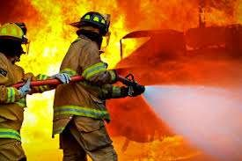
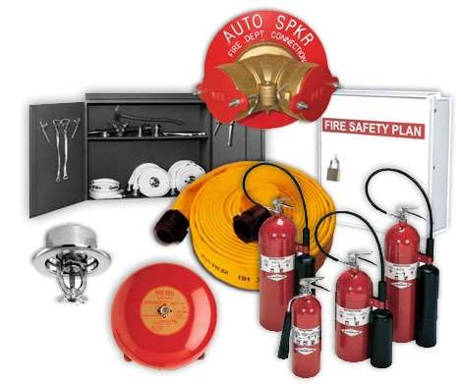
FIRE PROTECTION SYSTEMS
Unit - 3

Slide 2
Fire Classes
A Trash Wood Paper
B Liquids Grease
wood
paper
cloth
etc.
gasoline
oil
grease
other solvents
C Electrical Equipment
magnesium
sodium
potassium
titanium
other flammable metals
D
COMBUSTIBLE
computers
fax machine
other energized electrical equip.
METALS
Notes:
DESCRIBE THE FIVE FIRE CLASSES ON THIS AND NEXT SLIDE.
POINT OUT OLD AND NEW FIRE SYMBOLS--USED TO MARK EXTINGUISHERS FOR SUITABILITY FOR USE ON FIRE CLASSES.
TO DECIDE IF EXTINGUISHER IS APPROPRIATE, MATCH SYMBOL TO TYPE OF FIRE BEING ENCOUNTERED.

Slide 3
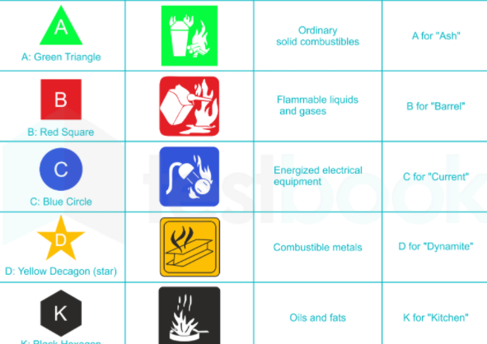
Fire Classes

Slide 4

Fire Classes (cont.)
CLASS K FIRES
Recently recognized by NFPA 10
Fires involving combustible oils, lards and fats in commercial cooking.
K Cooking Media
Notes:
RECENT ADDITION TO NFPA 10.
DESIGNED FOR USE WITH HOTTER BURNING NON-SATURATED FAT FIRES.

Slide 5
Fire Protection
A method of fire protection involves the conveyance of water pipes to extinguish fire within a building falls into the field of plumbing.
Effectiveness of Water as a good extinguishing agent lies in its cooling power and done in variety of ways as solid, steam, and atomised
Use of different nozzles cut down the quantity of water use and minimizes the wastage of water.

Slide 6
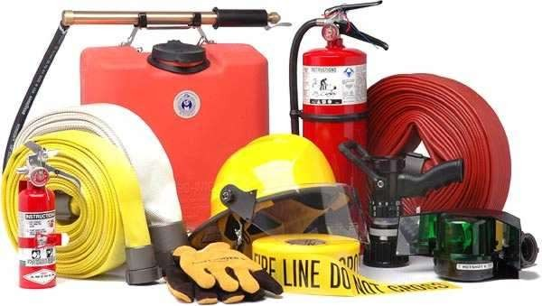
Fire Protection
Passive fire protection
Does not involve any motion or response
Active fire protection
Involves certain amount of motion and response in order to work

Slide 7
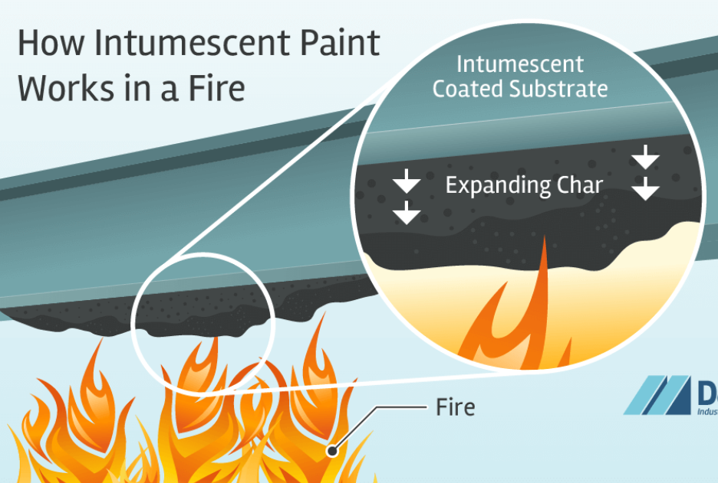
Passive fire protection
Fire-resistance rated walls
firewalls
fire-resistant glass
using multi-layer intumescent technology or wire mesh embedded within the glass may be used in the fabrication of fire-resistance rated windows in walls or fire doors

Slide 8

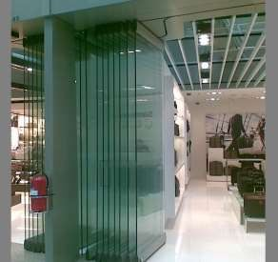

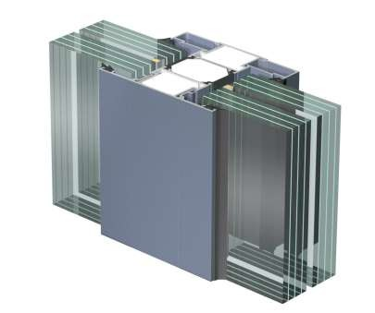

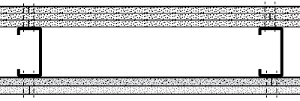

Fire-resistance Rated Walls

Slide 9
Active fire protection
Fire suppression
Fire can be controlled or extinguished, either manually (firefighting) or automatically
Sprinkler systems
They are usually located at ceiling level and are connected to a reliable water source, most commonly city water

Slide 10
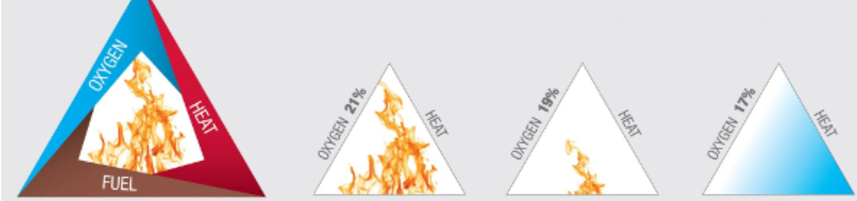
Categories of Active Fire Protection
Fire detection
Fire is detected either by locating the smoke, flame or heat, and an alarm is sounded to enable emergency evacuation as well as to dispatch the local fire department.
Hypoxic air fire prevention
Fire can be prevented by hypoxic air. Hypoxic air fire prevention systems, also known as oxygen reduction systems are new automatic fire prevention systems that reduce permanently the oxygen concentration inside the protected volumes so that ignition or fire spreading cannot occur.

Slide 11
Requirement of Water
The quantity of water required for fire extinction depends upon the magnitude of fire and duration taken to extinguish it.
The size of main ring, dry riser and wet riser, for fire fighting within a building, is designed keeping in mind that a distant hydrant will discharge about 1000 litres per minutes at 3.5 kg/sq.cm pressure. And at any given time at least two hydrants are in operation.

Slide 12
Storage of Water
A sufficient Quality of water for the purpose of fire fighting of the building must be made available in an underground tank within the premises.
Tank capacity may be taken as 30 min water supply at 1000 litres per minute.
The water tank and cover should be designed to take load of 18 tonnes vehicular load if flush below ground level.

Slide 13

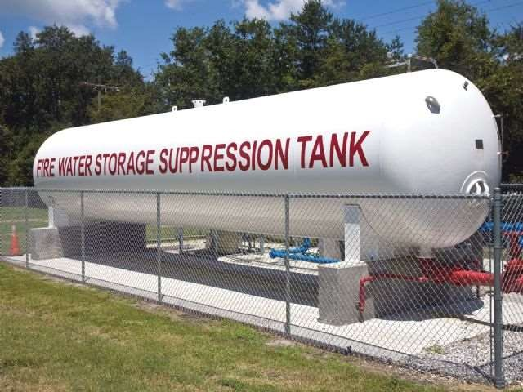

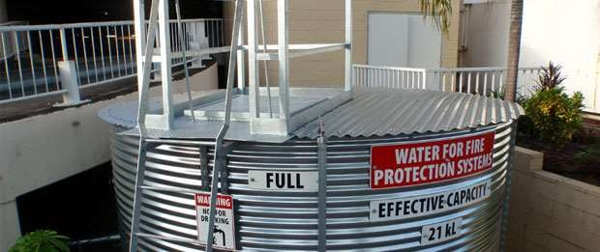

Storage of Water

Slide 14























































































Systems of Fire Fighting
It may be broadly classified as external (City) and Internal ( Building) fire fighting System
External Fire fighting System
Fire hydrant are generally located at a distance apart of about 90 m to 120 m in inhabitant area and about 300 m in an open area. One fire hydrant for every 4000 to 10000 sq. area is normally provided.
Hydrants are generally provided at street crossings, water demands of one litre per head per day is considered for fire hydrants. Fire hydrants are of two types pillar or post hydrant and sunk or flush hydrants.

Slide 15
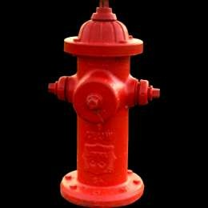

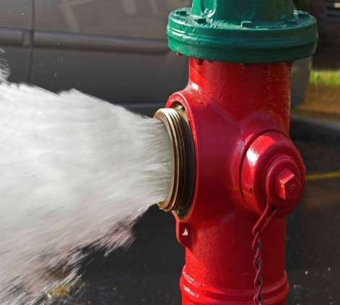

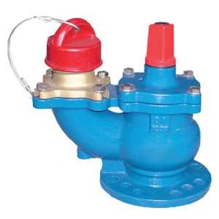

External Fire fighting System

Slide 16
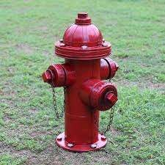
Pillar or Post Hydrant
These hydrant remain standing above ground like a post by about 0.9 m to 1.2 m and connected to a water main underground.

Slide 17
Internal Fire Fighting System
The local self govt i.e. Municipal Authorities have been empowered to make by laws to protect lives & properties for fire protection system within their municipal limits. These bylaws are generally based on NFPA (National Fire Protection Act).
The following methods are classified to extinguish fire within the buildings.

Slide 18












Residential Premises Fire Protection System
Fire Hose System Dry Riser/ Wet Riser
Automatic Sprinkler Systems
Potable fire extinguishers
Fire alarm Systems

Slide 19








Industrial Fire Fighting System
High velocity Water Spray
Medium Velocity fire spray
Foam
Dry chemical Powder
Carbon dioxide
Alarm Gong
Portable fire extinguisher
Fire alarm System

Slide 20
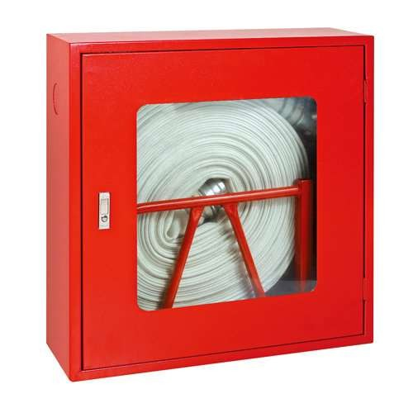
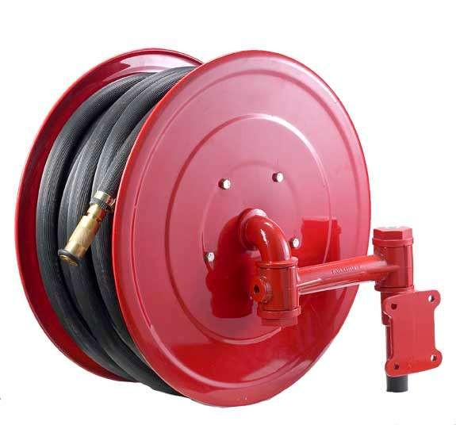
Fire Hose System
This system involves the installation of vertical riser pipe with hose connections at strategic points throughout the building.
The standpipe or riser can be kept filled with water is know as wet riser system otherwise it is known as dry riser system
The main features of these systems includes:
Hose & Automatic Sprinkler System
The courtyard of the building should have at least two fire hydrant.
The pumps will have a RPM not exceeding 2000
These hydrants are connected to an overhead/ storage tank for fire fighting

Slide 21
Automatic Sprinkler System
Automatic sprinklers are connected to a water distribution system.
A sprinkler nozzle is closed by a fusible plug that melts at a predetermined temperature, above normal room temperature, releasing water to fall on the source of heat
Sprinklers have the advantage of quickly supplying water to fire before it gain dangerous headway and of preventing the access of air to the fire by smothering it with water.

Slide 22
Sprinkler Classification
An automatic sprinkler head is a fire extinguisher nozzle, closed in a state of readiness by a heat sensitive release element.
The sprinkler may be classified as :
(a) Sprinkler based on Release:
Fusable element Sprinkler is opened under the influence of heat by the melting of eutectic metal or chemical.
(b)Glass bulb sprinklers are opened under the influence of heat by the destruction of the glass bulb through pressure of the fluid enclosed therein.

Slide 23
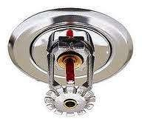
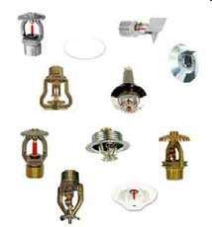
Sprinkler Classification
Sprinkler based on water distribution
Conventional Sprinkler – The Conventional sprinkler have a spherical water distribution directed towards the ground and the ceiling for the definite protection area.
Umbrella Sprinklers- The umbrella sprinklers have a parabolic water distribution directed towards the ground for a definite protection area with some of water sprays the ceilings
Sidewall Sprinkler- The sidewall sprinkler has a one –sided half-parabolic water distribution directed towards the ground for a definite protection area.

Slide 24
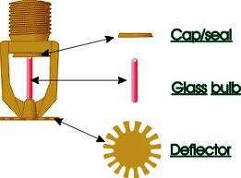

Frangible Bulb Head

Slide 25
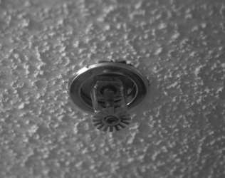

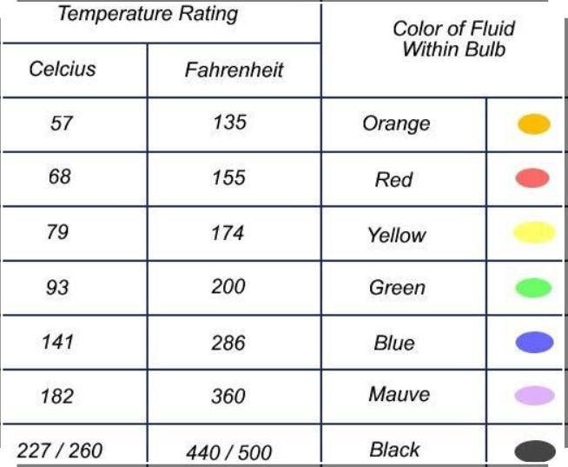
frangible bulb

Slide 26
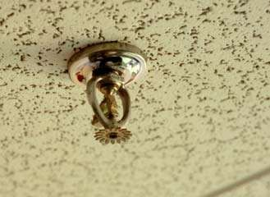

fusible link

Slide 27
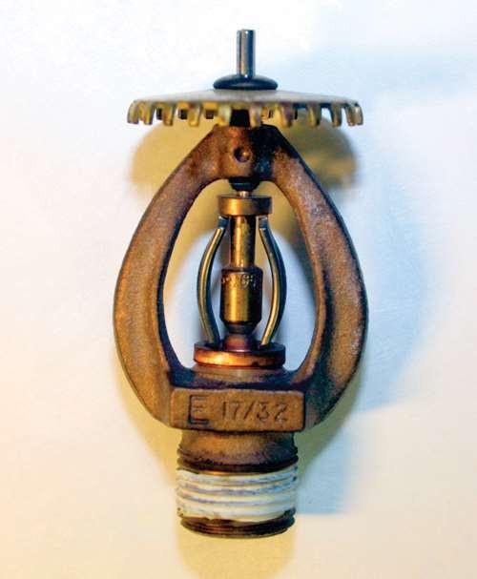

Chemical pellet

Slide 28
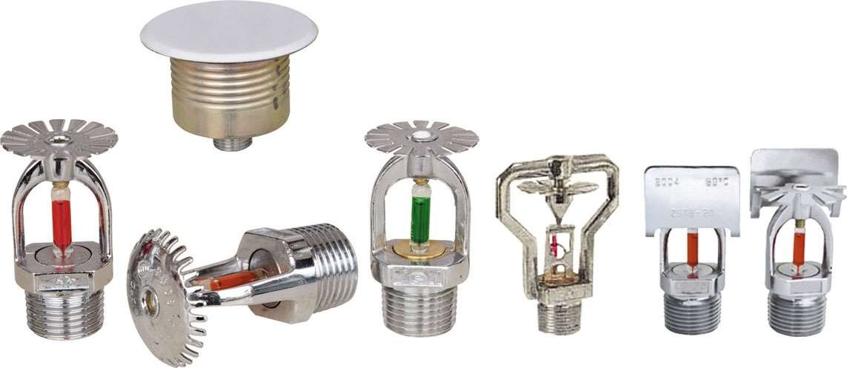

Sprinkler Classification

Slide 29
Fire Extinguisher Anatomy
PRESSURE GAUGE
(not found on CO₂
extinguishers)
DISCHARGE LEVER
DISCHARGE LOCKING PIN
AND SEAL
CARRYING
HANDLE
DISCHARGE HOSE
DATA PLATE
DISCHARGE NOZZLE
BODY
DISCHARGE ORIFICE
Notes:
POINT OUT DIFFERENT COMPONENTS OF PORTABLE FIRE EXTINGUISHER.
POINT OUT THAT CO₂ EXTINGUISHER IS UNIQUE IN THAT IT DOES NOT HAVE PRESSURE GAUGE.

Slide 30
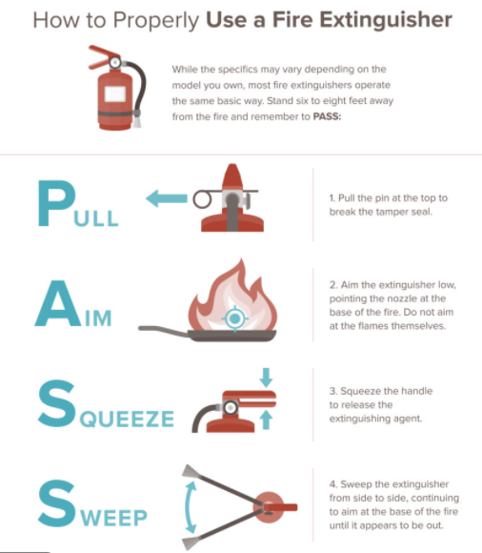

Slide 31
Fire Extinguisher Types
PRESSURIZED WATER
Class “A” fires only
2.5 gal. water (up to 1 minute discharge time)
Has pressure gauge to allow visual capacity check
30-40 ft. maximum effective range
Can be started and stopped as necessary
Extinguishes by cooling burning material below the ignition point.

Slide 32
Fire Extinguisher Types (cont.)
CARBON DIOXIDE (CO₂)
Class “B” or “C” fires
2.5-100 lb. of CO₂ (8-30 seconds discharge time)
Has NO pressure gauge--capacity verified by weight
3-8 ft. maximum effective range
Extinguishes by smothering burning materials
Effectiveness decreases as temperature of burning material increases.

Slide 33
HALON SYSTEM
Halons are halogenated hydrocarbons in which on or more hydrogen atom have been replaced by atoms from halogen series like fluorine, bromine, chlorine.
Super extinguishing property and relatively low toxicity
The extinguishing effect is due to the cooling or dilution of oxygen or fuel vapour minor.
USES:
Gaseous and liquid flammable materials
Electrical hazards such as transformer switches and circuit breaker
Data processing equipment and control rooms.
HALON 1301 is referred as chain breaking agent where it can control combustion process

Slide 34
Halon
Halon fire extinguisher is important device to have, especially for emergency situations. It contains a gas that interrupts the chemical reaction that takes place when fuels burn.
Halon fire extinguisher is often used to protect valuable electrical equipment since they leave no residue.
Such on expensive computers, server rooms, etc.
Since Halon manufacturing was banned, a hunt has been on for something that works as well. According to the Halon Alternatives Research Corp., more than 20 different kinds of alternatives exist as direct replacements.
Halon Replacement
Those categories are inert gases and halocarbon compounds.

Slide 35
INERGEN SYSTEM
Inergen is a mixture of three gases namely:
1.Argon 40%
2. Nitrogen 52%
3. Carbon dioxide 8%
It extinguishes fire by diluting the oxygen present
FOAM
Aqueous film forming foam used on A and B fires
Alcohol resistant aqueous film forming foam used on fuel fire containing alcohol

Slide 36
























































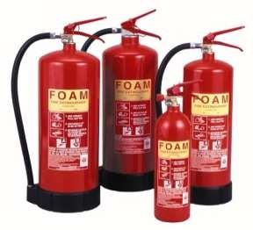

Methods of Fire Extinguishing
Foam System
Foam system has earned recognition as a effective method. Foam systems are specially suited for fires in oil storages, flammable liquids such as benzoyl, petrol, alcohol, and lighter petroleum products. In this system fluroprotein foam compounds is applied forcefully to burnin hydrocarbon liquid which prohibits fire spread. This system is generally operated manually.

Slide 37
Methods of Fire Extinguishing
Dry Chemical Powder:
Dry Chemical Powder used to combat fires in flammable liquids, gases and greases include such fires when involved with energized electrical equipment is a potassium bicarbonate based dry chemical. The chemical powder is free flowing, water repellent and non abrasive and when used as a fire extinguisher agent will produce no toxic effects. Because of its excellent fire fighting effectiveness this product is widely used in other high risk areas.
Carbon dioxide or Nitrogen is used as a expelling gas. This system can be effectively installed in restaurants, fuel stations etc.

Slide 38
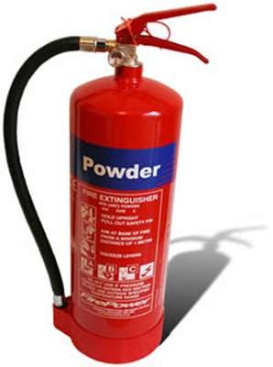
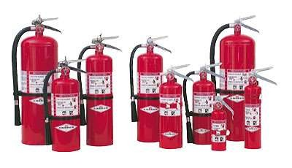


Dry Chemical Powder

Slide 39
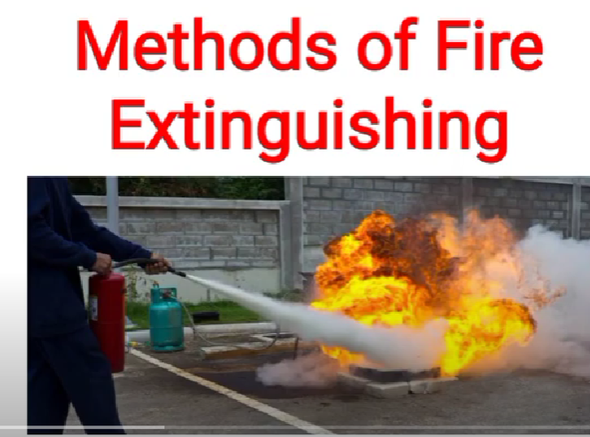
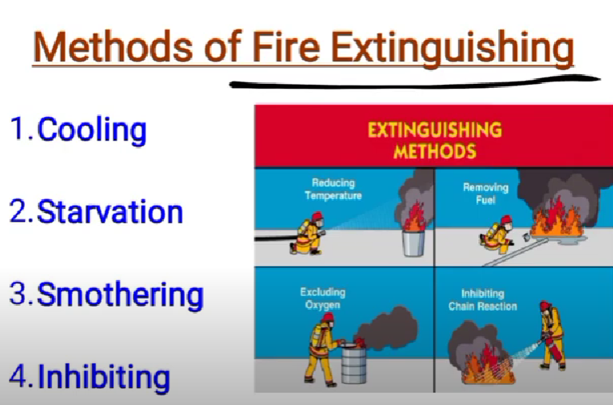

Slide 40
Methods of Fire Extinguishing
Carbon dioxide
Carbon dioxide has been used for many years to extinguish the flammable liquid fires and fire involving electrically energized equipment's. Carbon dioxide about one and half times as heavy air, a property that accounts for its ability to replace air above burning surface and maintain a smothering atmosphere, It is non combustible and does not react with most substances.
(a) Smothering effect: Carbon dioxide is stored under pressure as liquid, when released, it is discharged into the fire area principally as a gas. When released on burning material, it covers then and removes the oxygen to a concentration which cannot support combustion

Slide 41
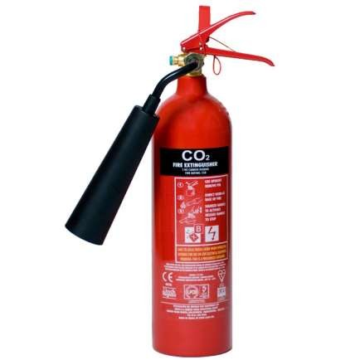

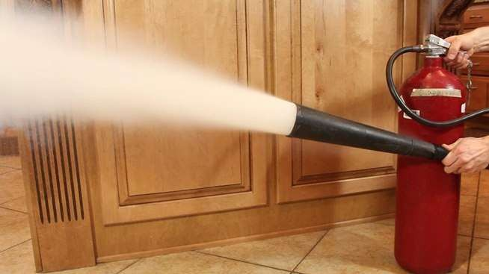

Carbon dioxide

Slide 42
Methods of Fire Extinguishing
Cooling effect:
The rapid expansion of liquid to gas when carbon dioxide is released from storage cylinder produces a refrigerating effect that converts part of the carbon dioxide into snow. This snow, which has a temperature of 80 ⁰C soon sublimes into gas, absorbing heat from the burning material and surrounding atmosphere.

Slide 43



















































































Portable Fire Extinguisher
Portable extinguishers are manufactured in a variety of shapes & sizes. In order to avoid confusion, extinguisher of the same type, should be similar in shape, appearance and as far as possible, in method of operation. It is also advisable to standardize the sizes, if possible although in some instances less heavy models may be desired, where for example, women are likely to use extinguisher.
The extinguisher should be located in conspicuous positions on bracket or shelves where they can be readily noticed by persons following the normal escape route like exits and stair landing on each floor.

Slide 44
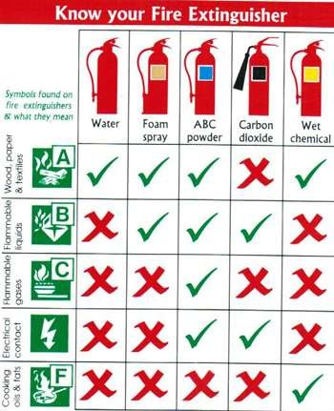
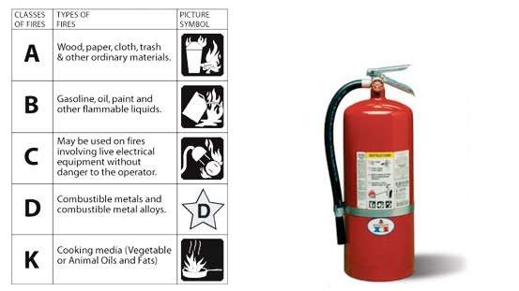


Portable Fire Extinguisher

Slide 45
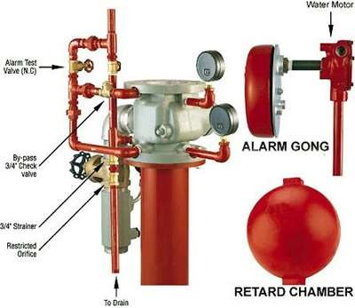
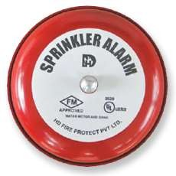
Alarm Gong
The sounding of alarm should occur shortly after the opening of a sprinkler head.
An alarm valve which is a type of back pressure valve, should be fitted on the main supply pipe immediately above the main stop valve.
In order to avoid false alarm caused by fluctuations in the pressure of supply, a device is necessary in most types of alarm systems to permit of such temporary fluctuations without lifting of the alarm.

Slide 46
Fire Alarm System
It is an integral part of any fire protection system.
It is said that the first five minutes of fire are most important than the next five hours.
Fire can be extinguished when it is in an incipient stage
Moreover people can be warned of fire hazards and evacuation of the buildings become easy.
The heat & smoke detectors detect fire and actuate the alarm system. The system helps evacuation of the premises and to bring fire fighting facilities into action as quickly as possible

Slide 47


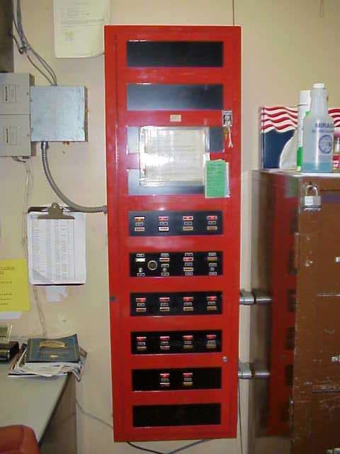
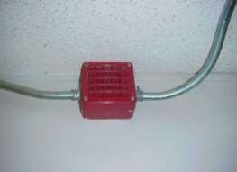


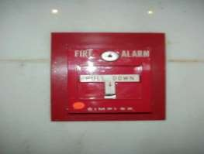

Features Of Fire Protection
ALARMS

Slide 48


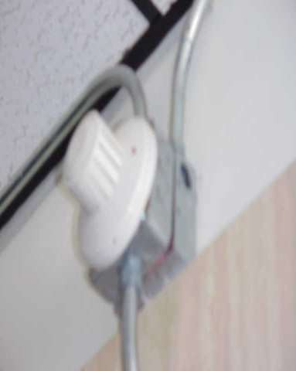
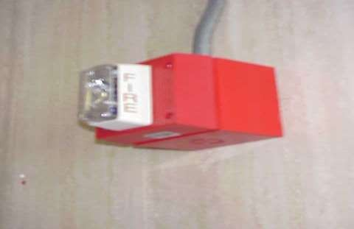


Other Features Of Fire Protection
DETECTORS & STOBES

